Slide 1
Power Study
IMU, Temp Sensor, 16% Duty Cycle
Transmitter: ~1% Duty Cycle
Timing:
Boot + 1 Transmit
Loop:
Sleep for 10 Seconds
Boot IMU+Env Sensor for 2 Seconds
Sleep for 10 Second
Goto Loop
LOW POWERED MCU

Slide 2
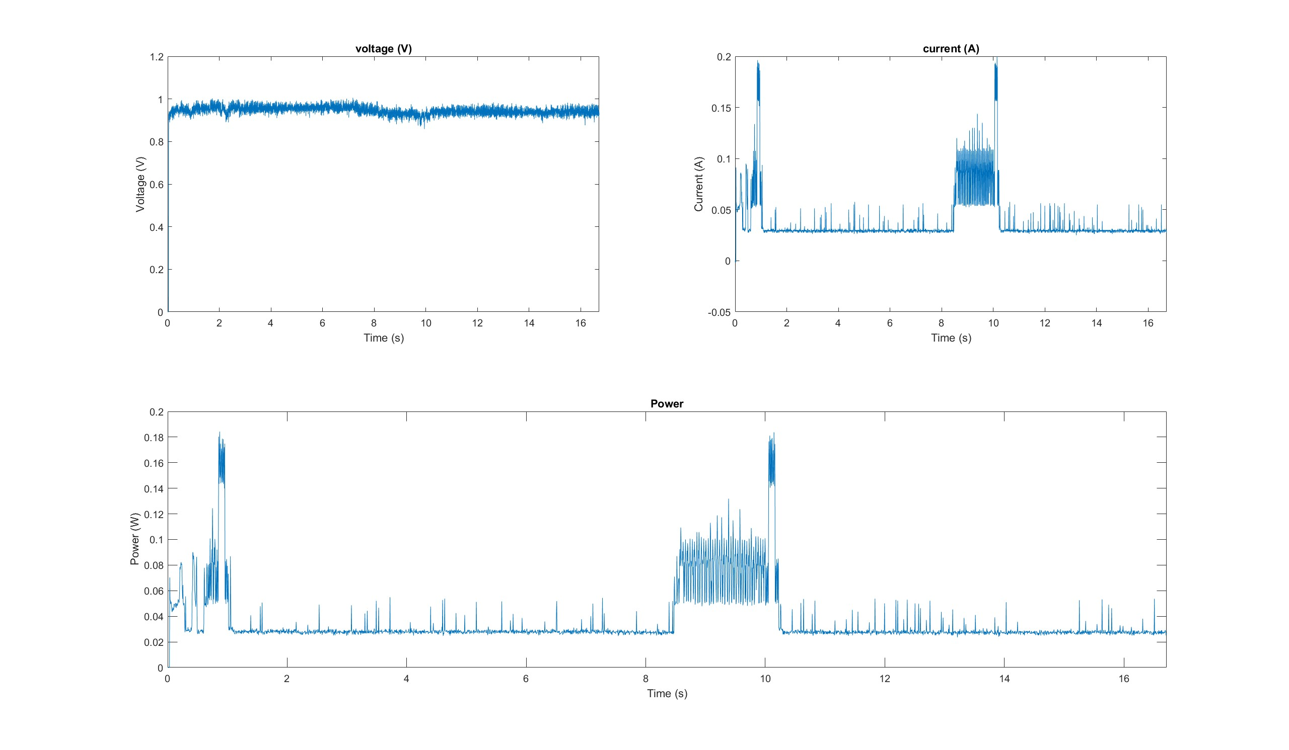
Small View
IMU On
Transmit
IMU Sleep

Slide 3
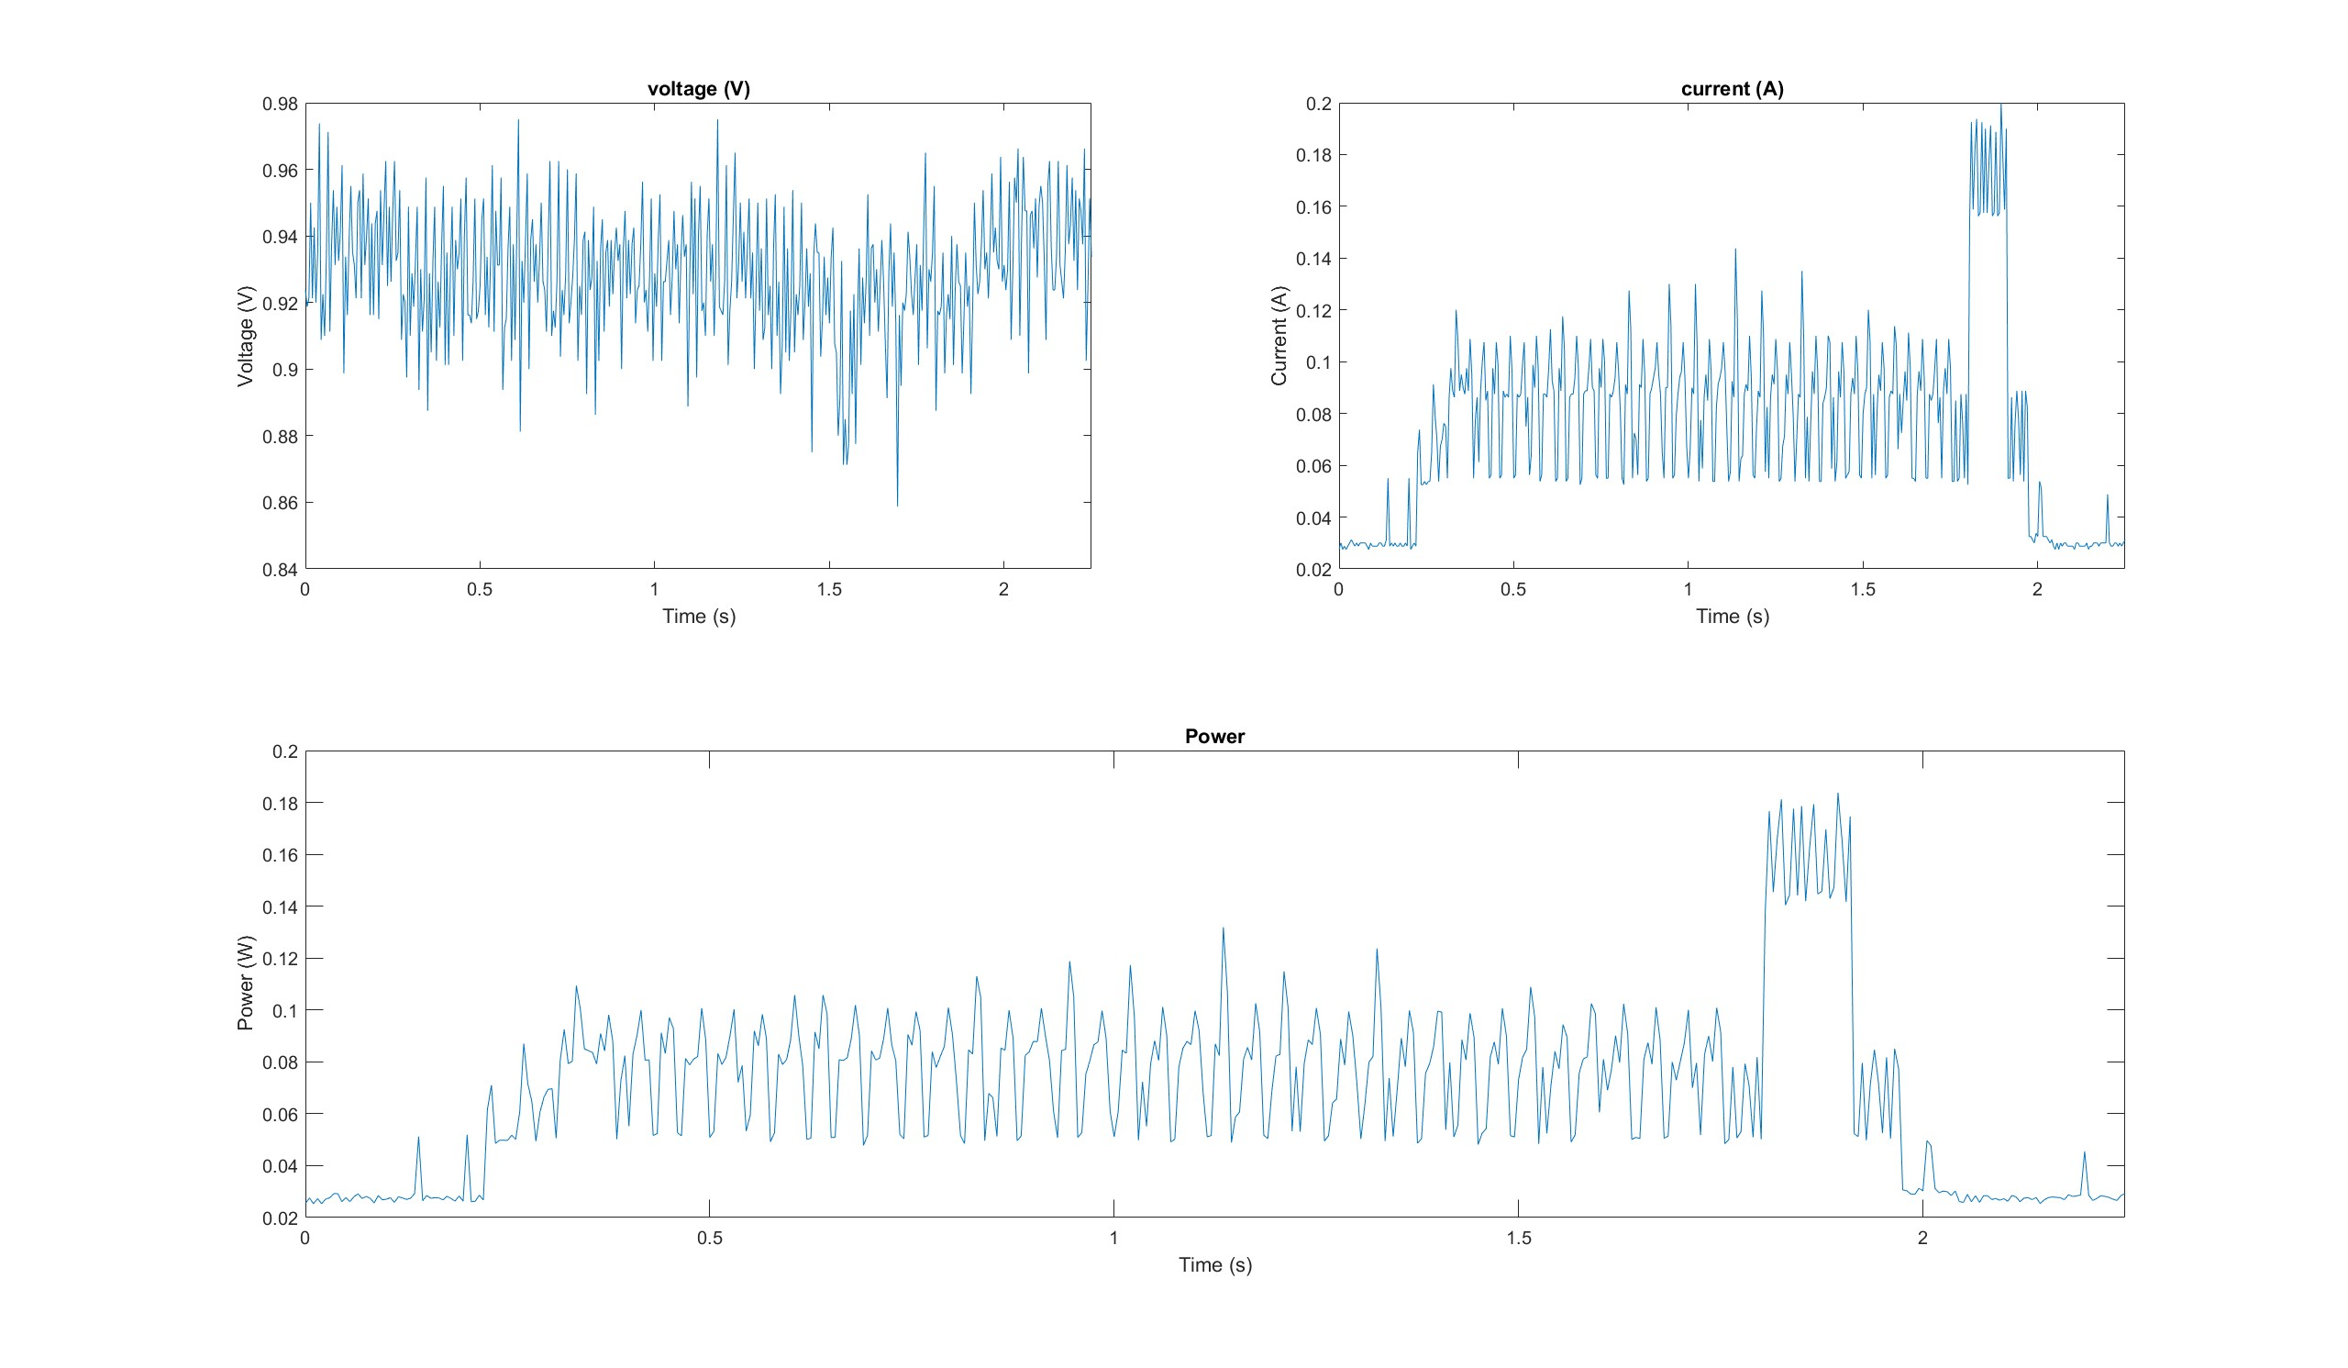
Super Small View
Energy ~=
0.1571 J
(From Integration under Power Curve)
Cap_E = ½*C*V^2
C = 2* Cap_E/(V^2)
Required Capacitance =
0.3142 F

Slide 4
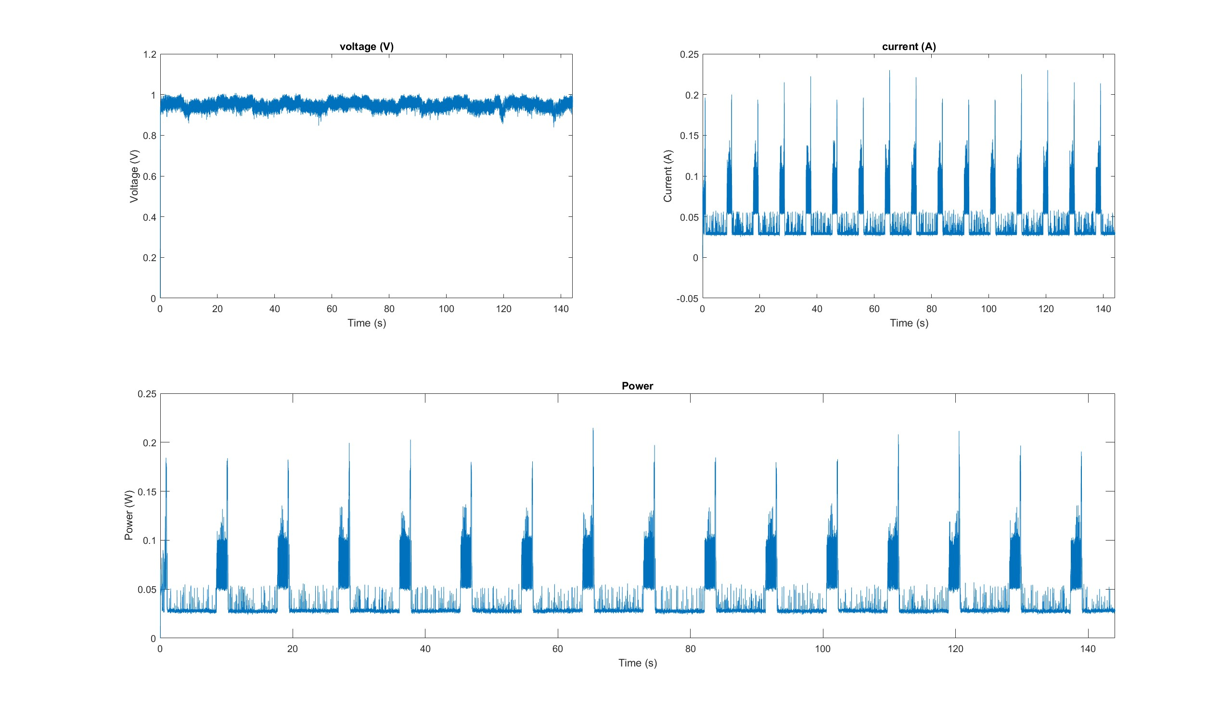
Medium View

Slide 5
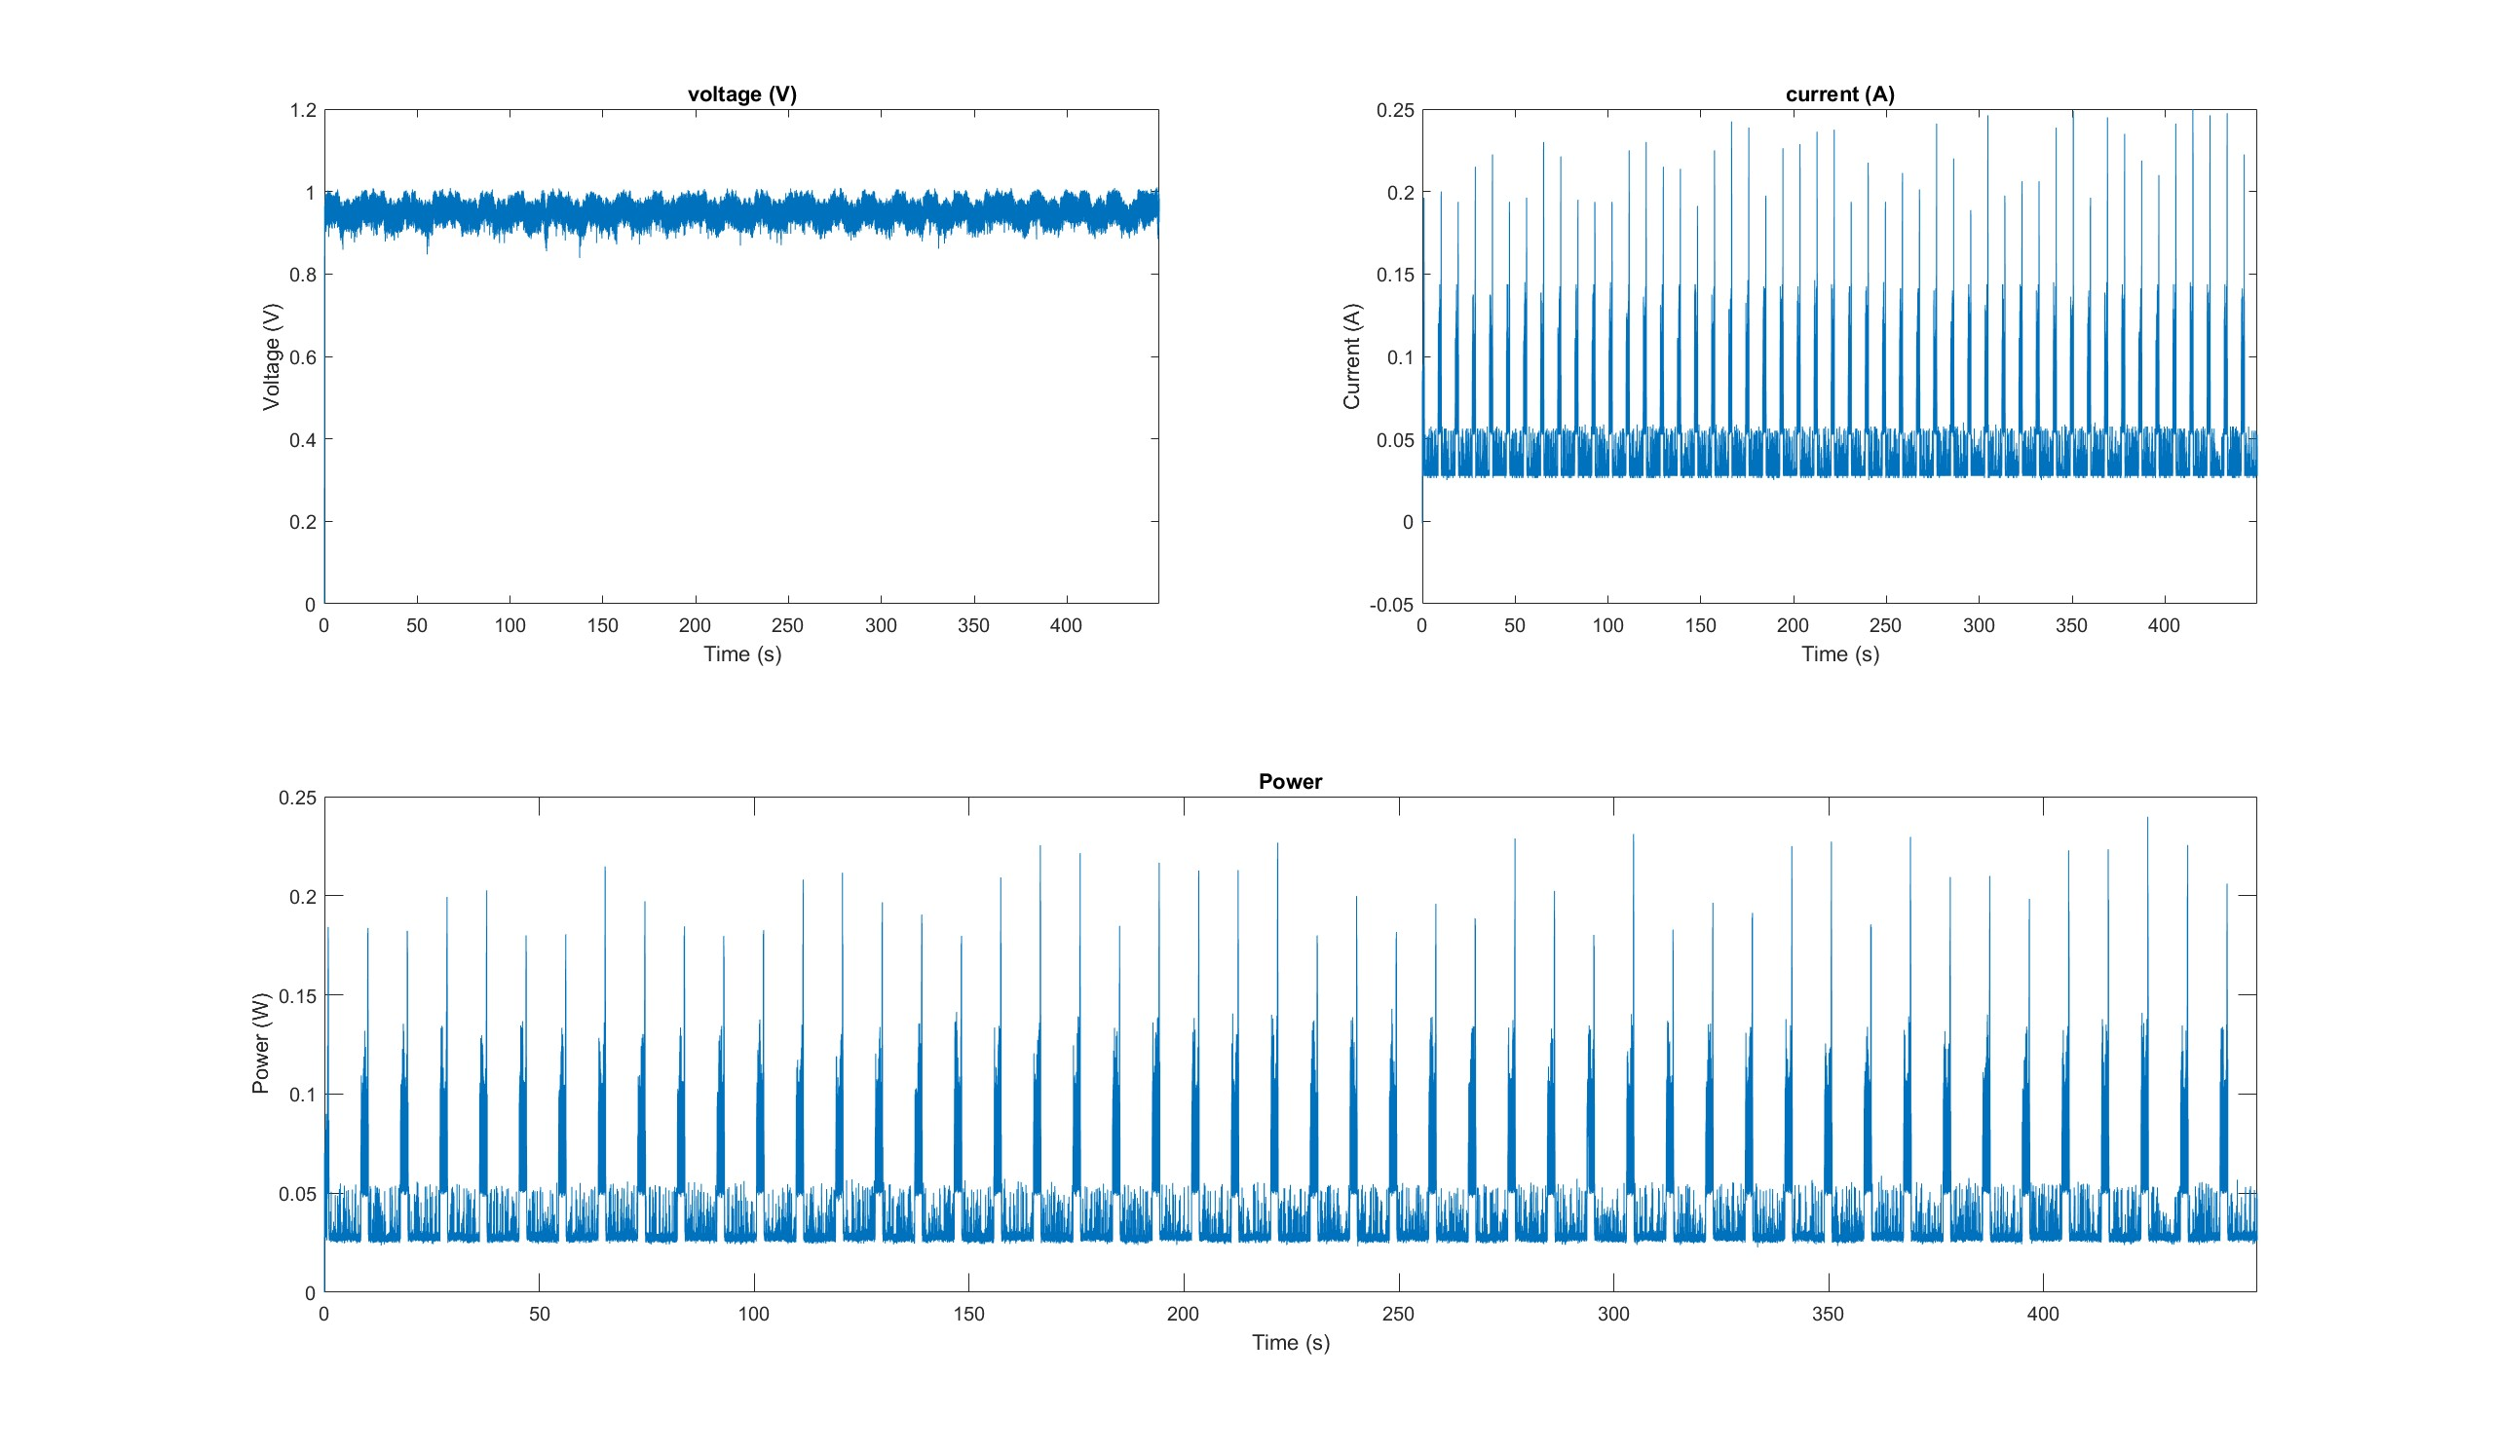
Big View: ~8 mins of Data

Slide 6
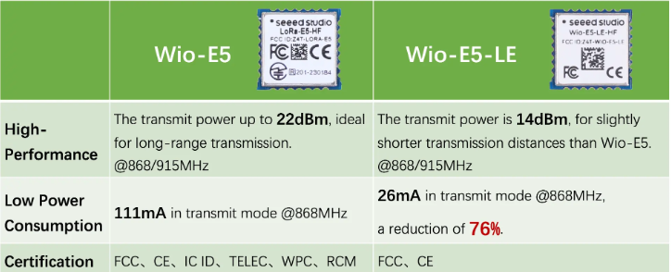
High Powered
Low Powered
LoRa Power Study
Transmission 50%
Timing:
Boot
IMU to Off
Loop:
Boot LoRa for 3 Seconds (~1 Transmission)
Sleep for 3 Second
Goto Loop
HIGH POWERED MCU
- The high powered MCU was put on by accident and consumes more transmission power than the low powered MCU by approximately 50%.

Slide 7
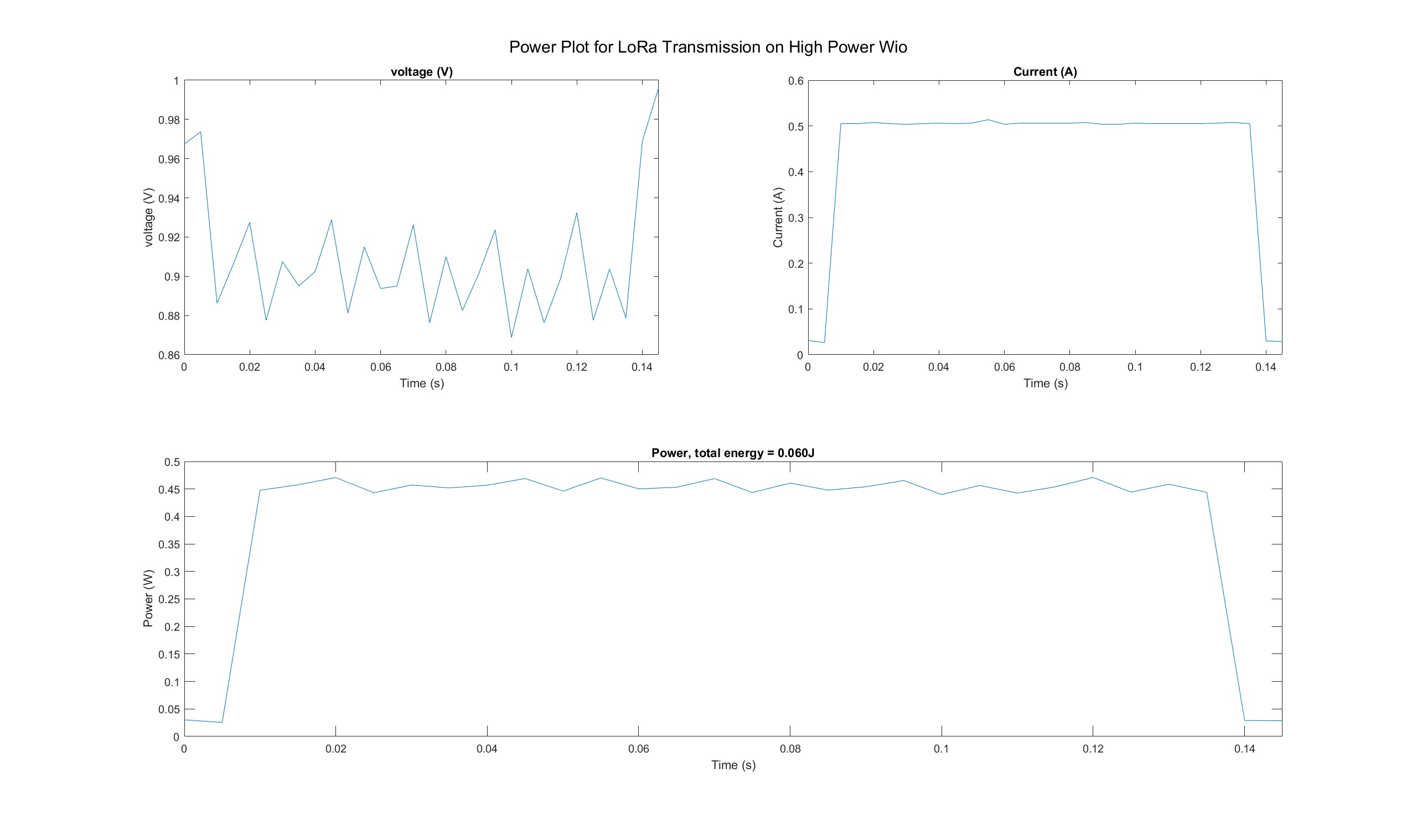
Single Transmission
Energy ~=
0.06 J
(From Integration under Power Curve)
Brown out from voltage regulator
(BO)
Cap_E = ½*C*V^2
C = 2* Cap_E/(V^2)
Required Capacitance =
0.12 F

Slide 8
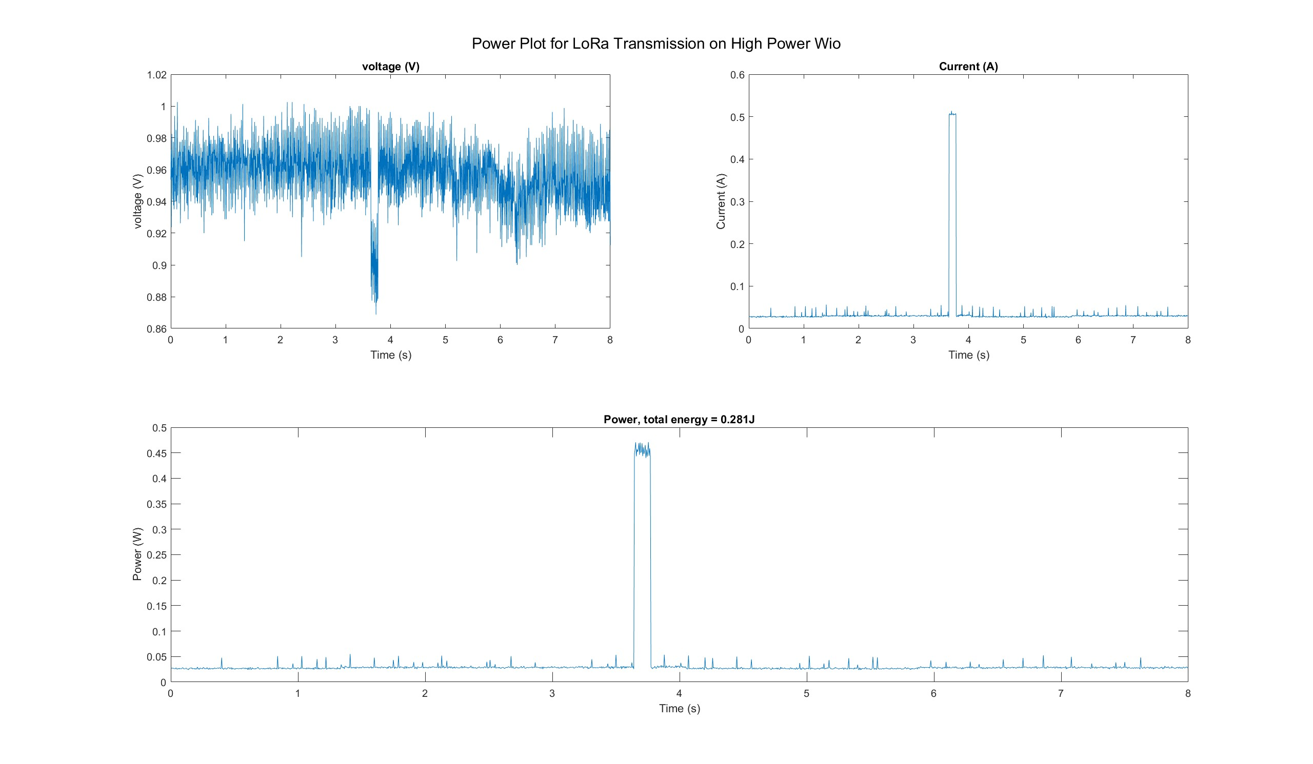
Sleep to Transmission to Sleep
Energy ~=
0.281 J
(From Integration under Power Curve)
(BO)
Cap_E = ½*C*V^2
C = 2* Cap_E/(V^2)
Required Capacitance =
0.5620 F

Slide 9
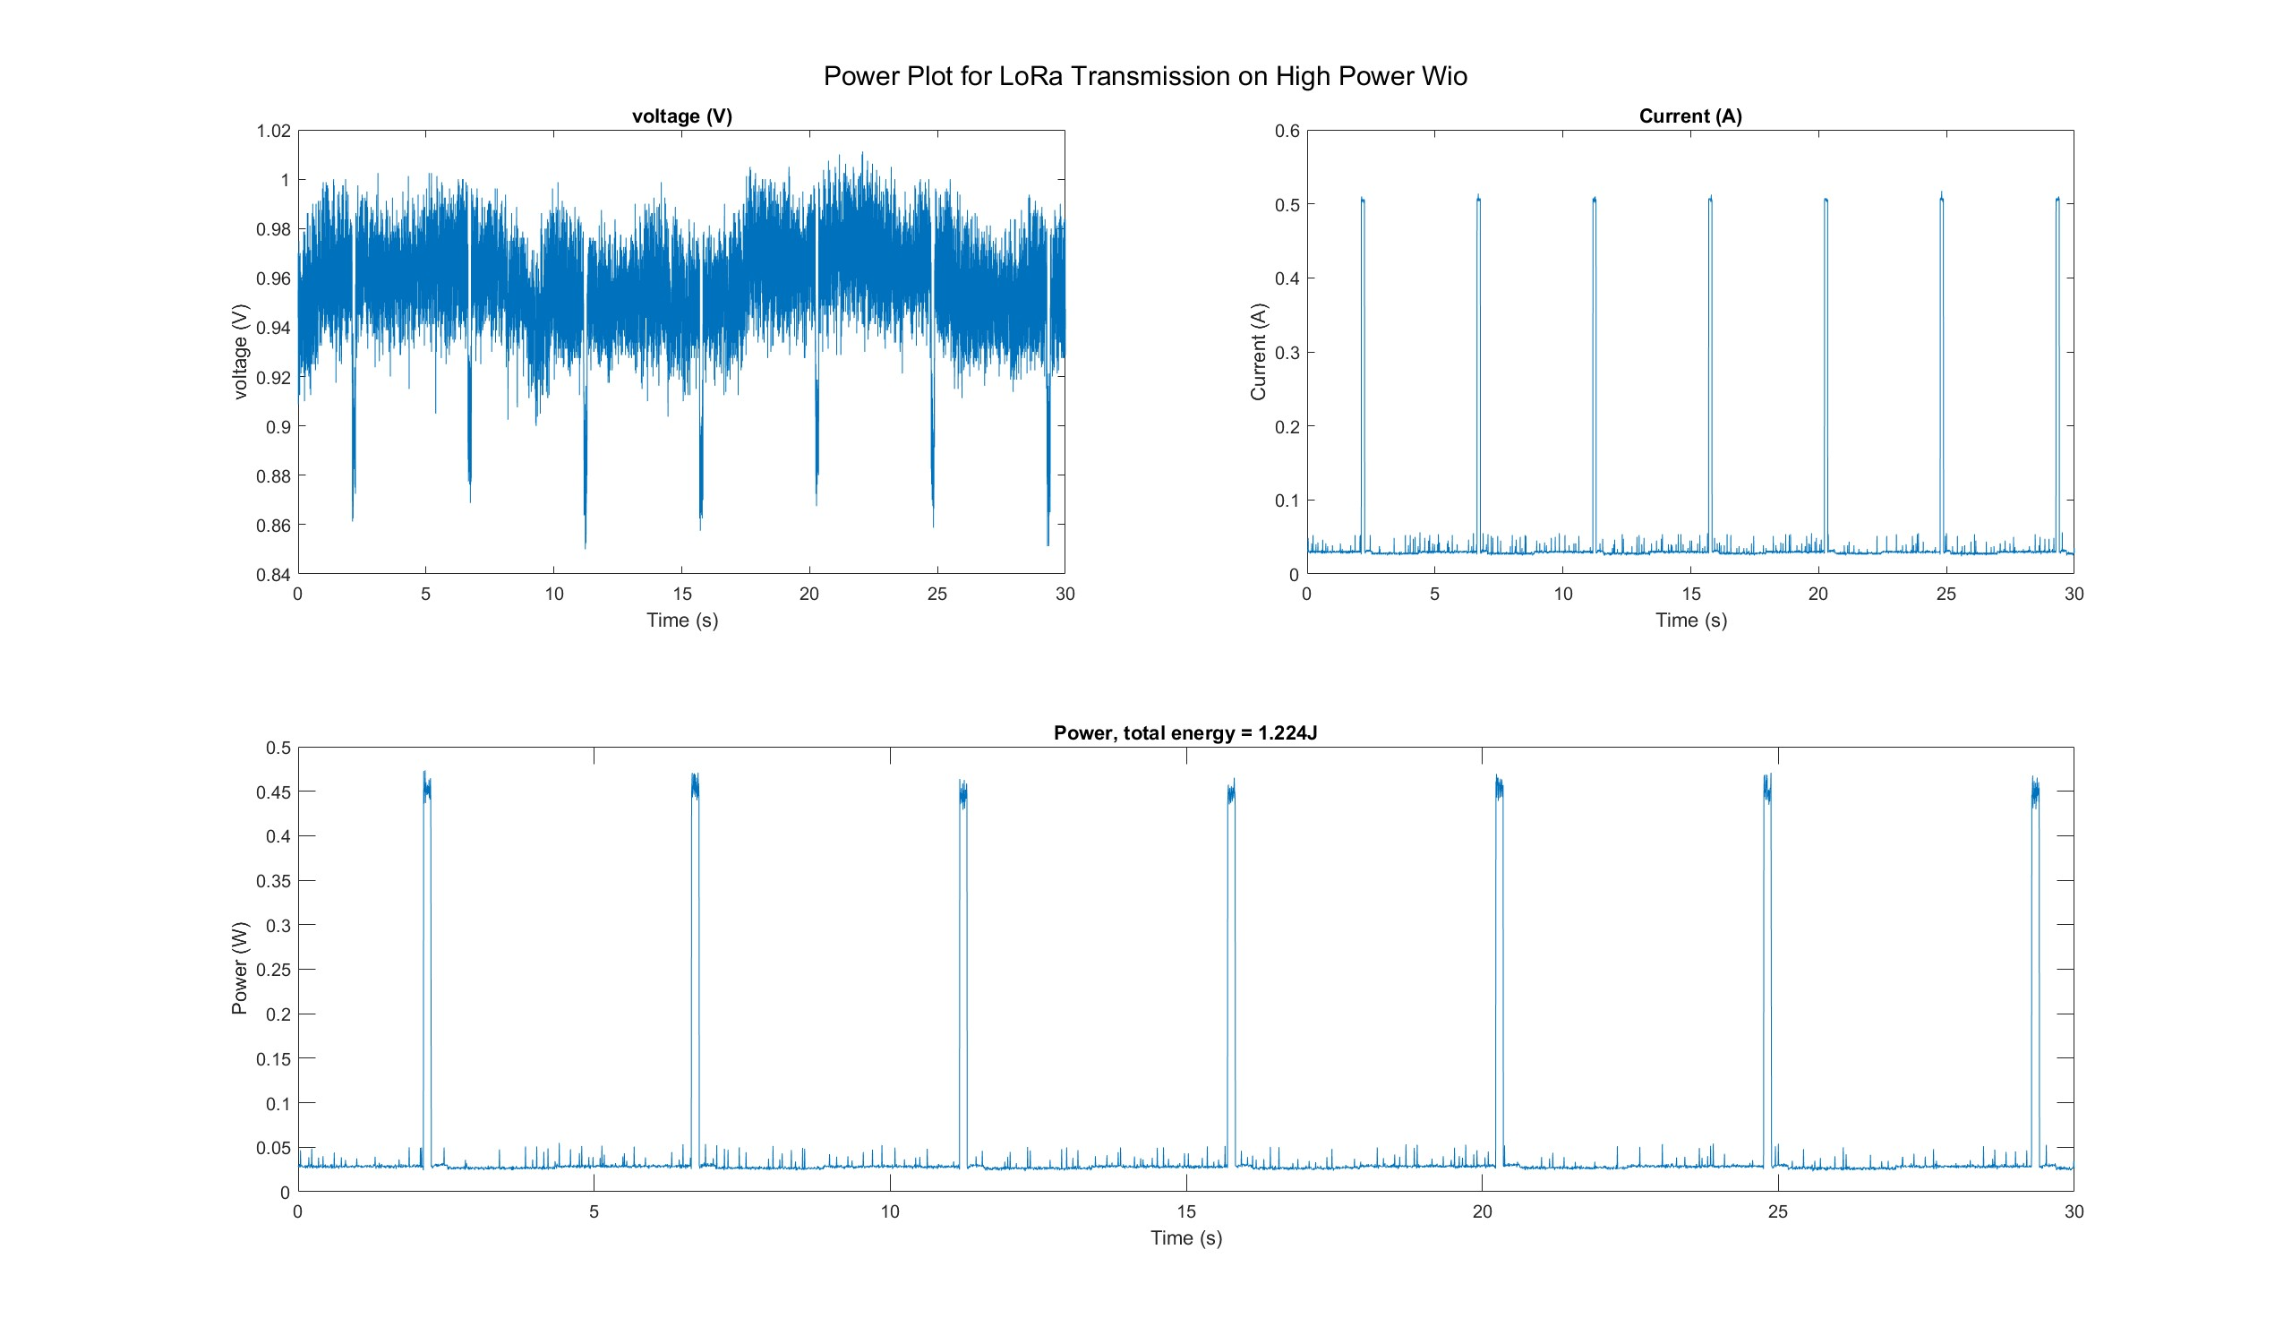
Medium View

Slide 10
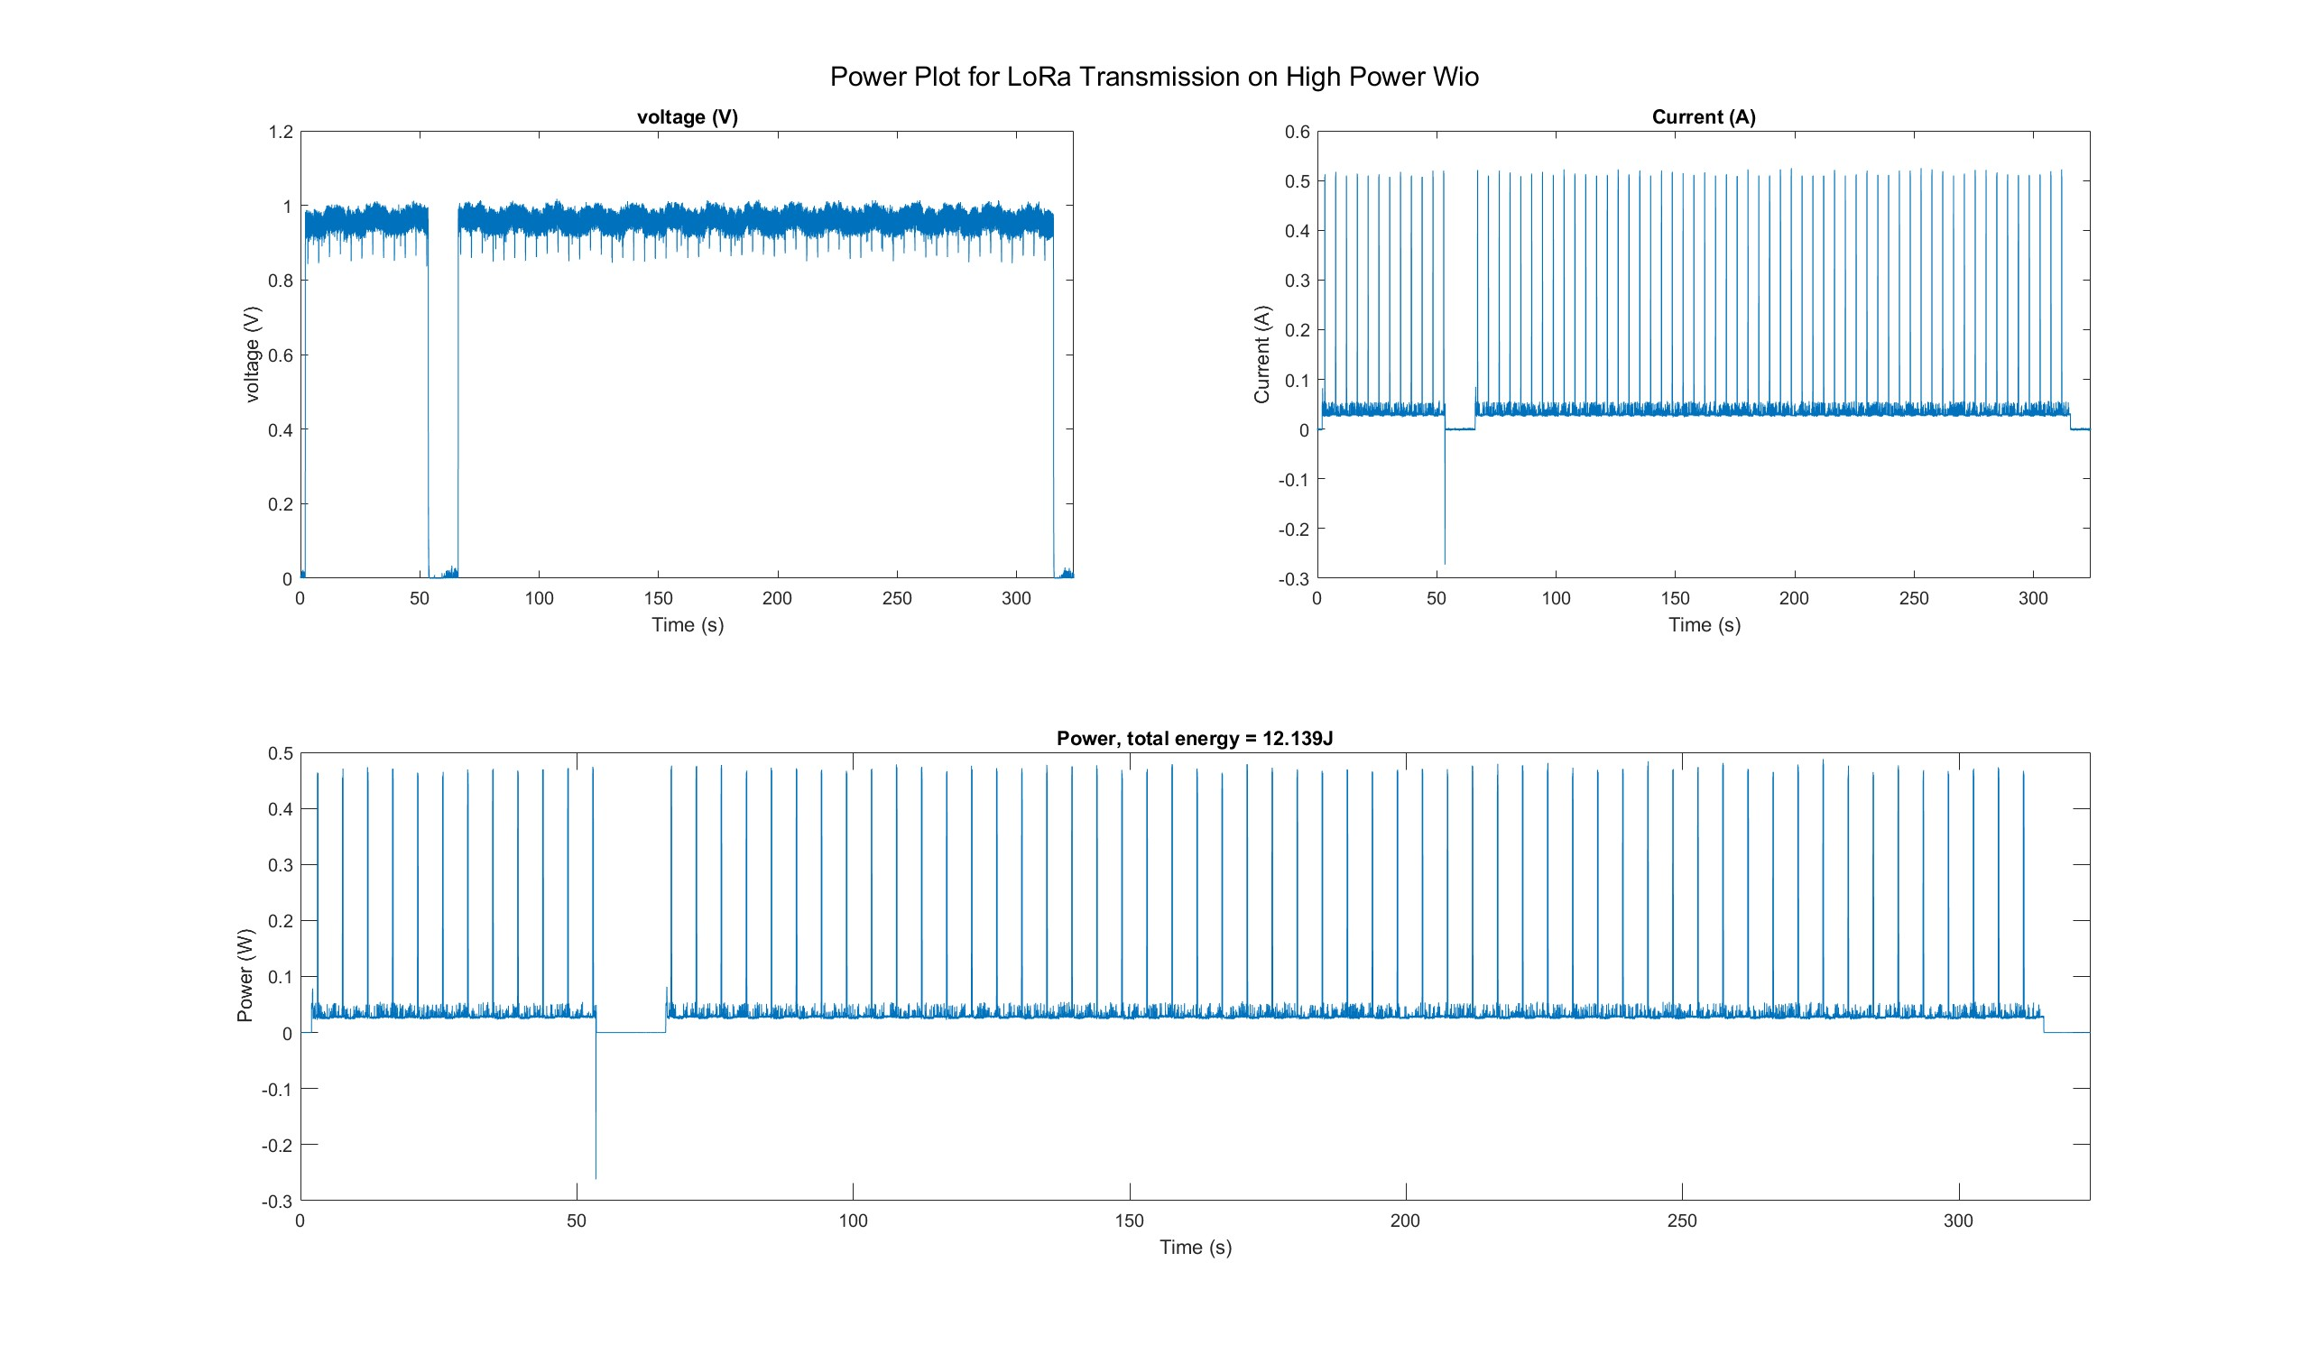
Large View (~5 min of data)
Accidently hit the power off button on the power supply

Slide 11
Total E for each Event
Processor
Processor+IMU
Processor+Transmitter
Put Temp Sensor to Sleep

